Slide 1
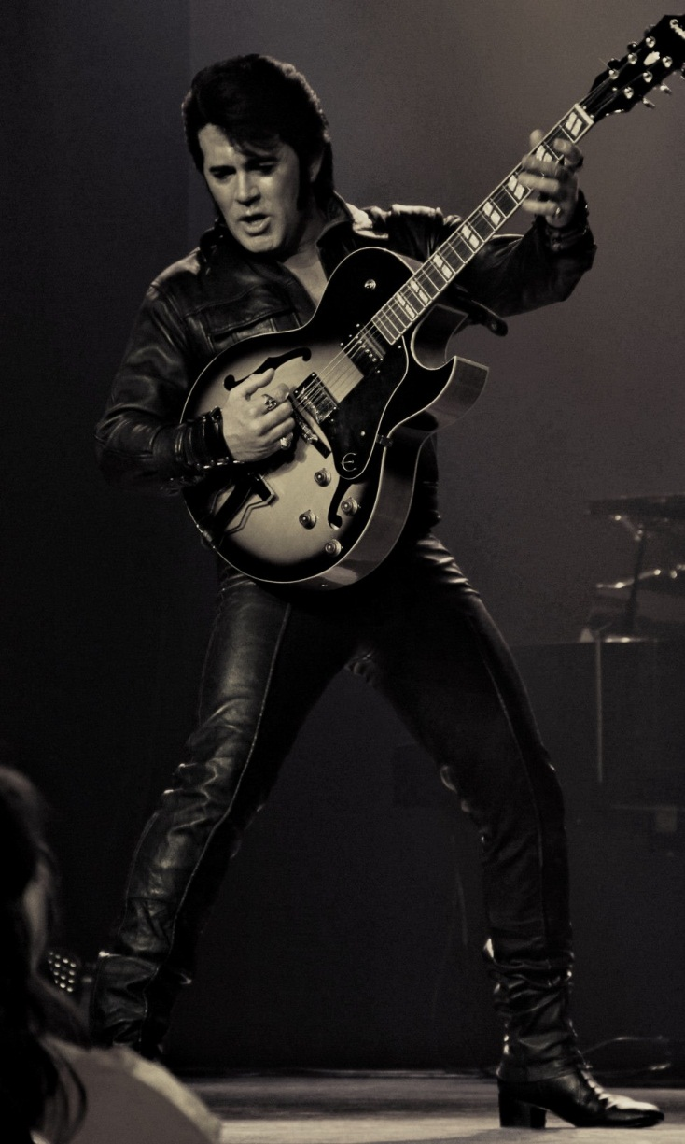
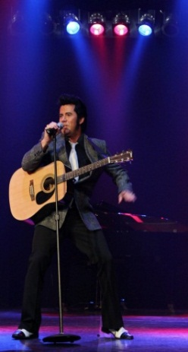
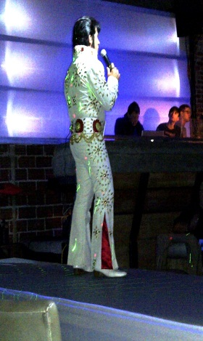
Mark Stevenz
Three Decades of Hits
One Premier Entertainer

Slide 2
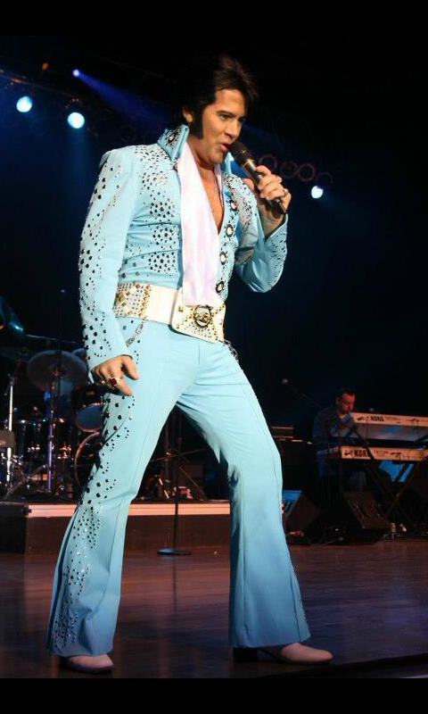
MARK STEVENZ as ELVIS
The Mark Stevenz Elvis Tribute “Experience” is the ultimate tribute to the King! Stevenz’ ability to authentically replicate the shake of the hips, the curl of the lip, the power behind
the vocals and get the audience to shake, rattle, and
roll along with him ensures an exhilarating trip down
memory lane for those who had the privilege of the
experience of Elvis and the development of new fans of
the classic and iconic songs that made Elvis, the King!
Stevenz brings with him trained and seasoned
Musicians and back-up singers to ensure that
every note perfectly compliments his smooth and
sultry vocals. Combined with costuming to provide an
experience authentic to the decade, Mark Stevenz
captivates the audience from the first note and leaves
them wanting more!

Slide 3
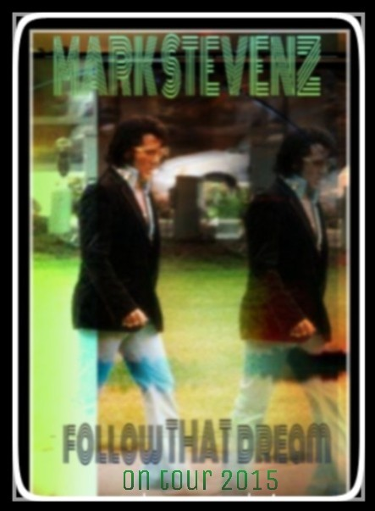
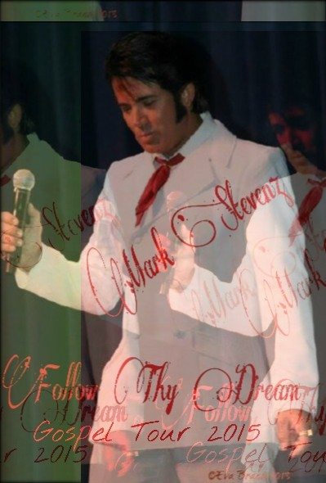
FOLLOW THAT DREAM (THE SHOW)
FOLLOW THY
DREAM
(THE GOSPEL SHOW)
Stevenz’ passion has driven his
need to perfectly replicate Elvis’
performances throughout all three decades. He has broken down the moves and vocal nuances to provide the audience with an authentic trip down memory lane. He has not missed a detail and he works tirelessly to ensure that his tribute to the “Kings’” work in the 1960’s, Gospel & throughout the1970’s replicates the true excitement Elvis brought to the stage.
THE SHOW

Slide 4
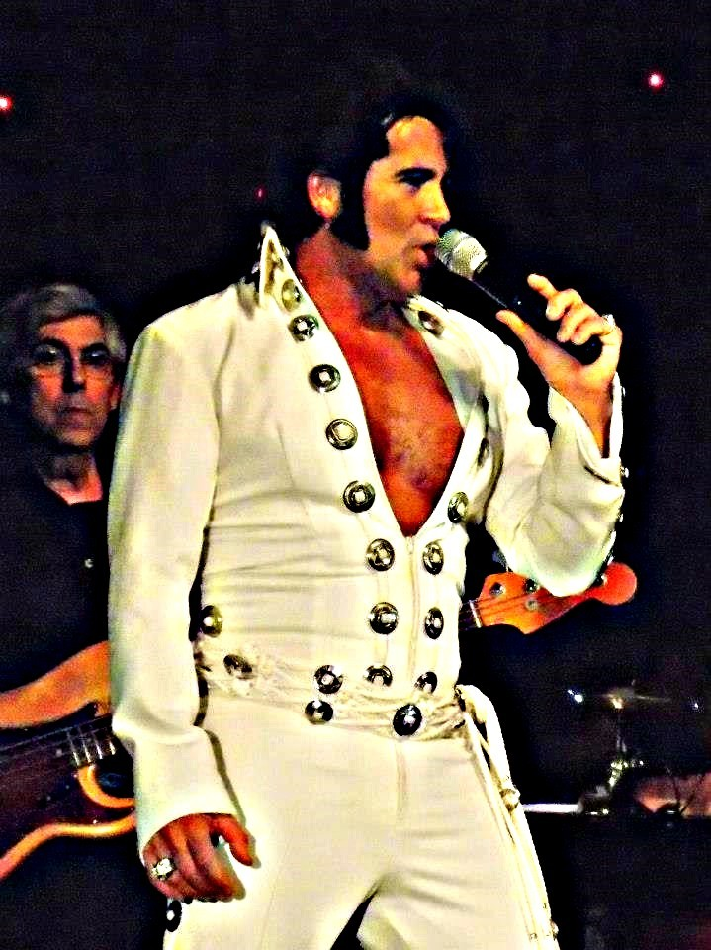
“Mark Stevenz is AMAZING in more ways than
one... Incredible entertainer, even more
incredible, “ELVIS” right down to the
mannerisms, voice inflections, and his
singing is right on Elvis... Mark Stevenz is
the best I’ve seen, hands down!”
~Scott Tom , DJ, The Eagle 106.7
Clear Channel Media & Entertainment
“I wasn’t sure if I wanted to go to the show because
there will never be
another Elvis, but I
was wrong. Mark took
me back to when I
saw the “King” LIVE in the early 70s! I
will definitely be back to see him again!”
~ Lottie Andrews
(A True Elvis Fan)
“This “Experience” was the most entertaining tribute to Elvis that I have ever witnessed. Mark nailed every iconic move and his sound was so incredible that I still get requests to bring him back. GREAT
SHOW!”
~ Joseph Moore PME
“Mark shook, rattled
and rolled us. SO much more
authentic than I expected.”
~John from Alberta Canada
“Mark Stevenz totally embodies the king & I have been to over 20 shows already & will go to every show I can.”
~ILA – Fan for Life
TESTIMONIALS

Slide 5
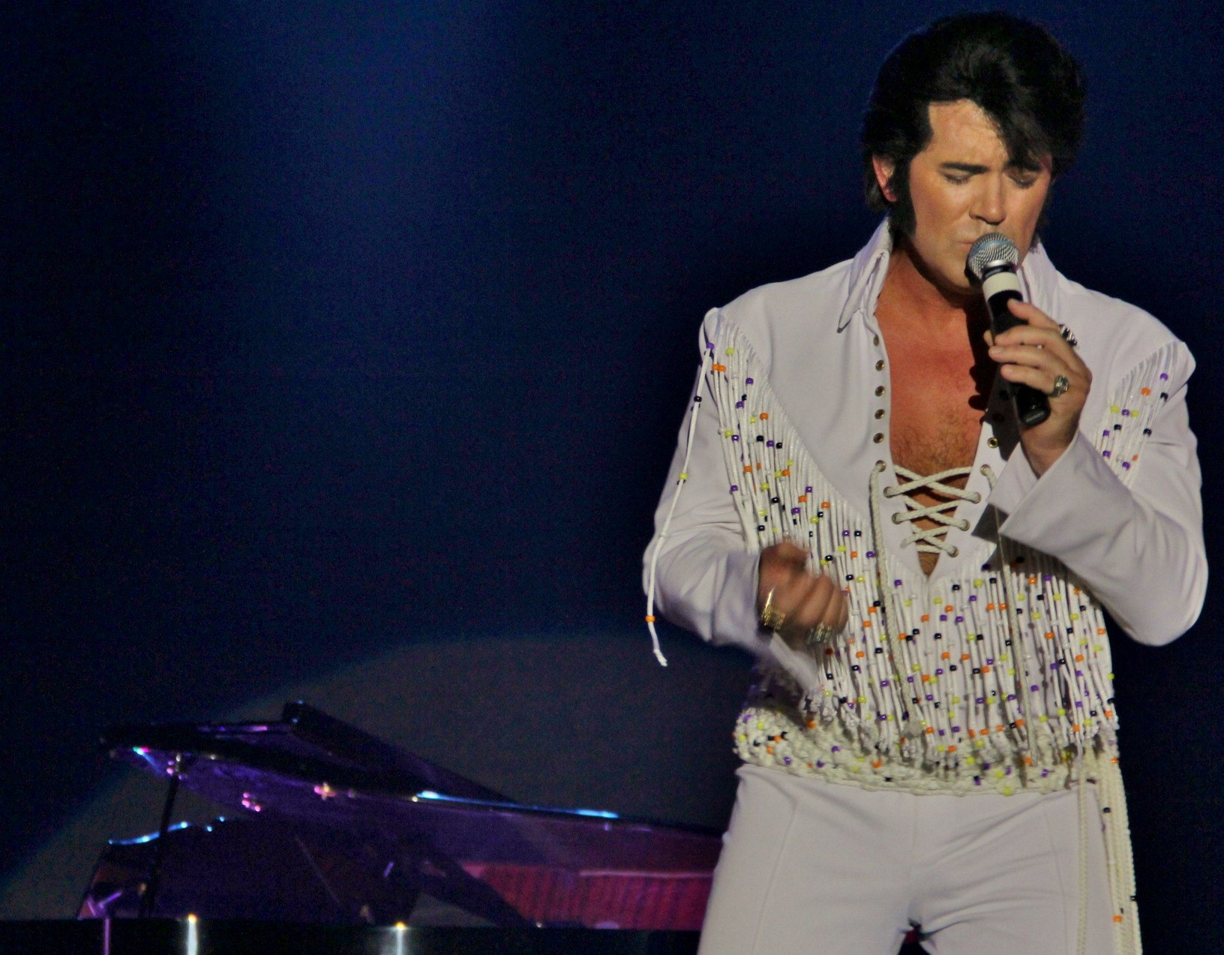
Mark has performed in over 200
performances worldwide including:
September 2014: Up Close & Personal w/ the Kings, Oregon
August 2014: Blue Suede Music Festival, Alberta, Canada
July 2014: View Royal & Nanaimo Casinos, Victoria, BC,
June 2014: Casablanca Casino, Mesquite, NV
May 2014: Horseshoe Casino, Council Bluffs, IA
March 2014: Pala Casino, Pala, CA
August 2013: Various Locations, Memphis, Tennessee
July 2013: Las Vegas Hilton, Las Vegas, NV
June 2013: Penticton Elvis Fest, Penticton, BC, Canada
May 2013: Riverside Casino, Laughlin, NV
April 2013: Various locations, Alberta, Canada
January 2013: Quechan Casino, Winterhaven, CA
October 2012: Elvis Fantasy Fest, Portage, IN
October 2012: The Poconos ELVIS Fest, the Poconos, PA
June 2011; Arlington Music Hall, Arlington, TX
July 2011: Chinook Winds Casino, Lincoln City, OR
Mark Stevenz
LIVE

Slide 6
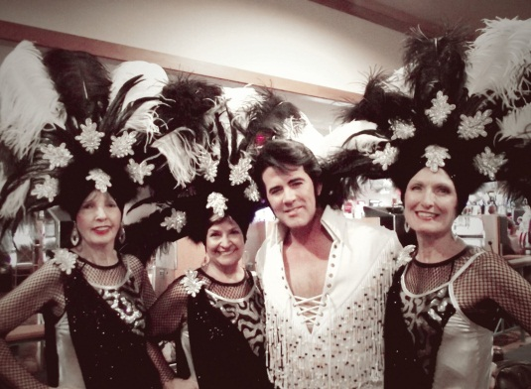
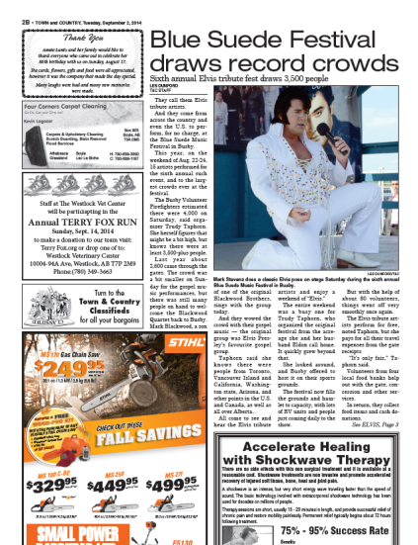
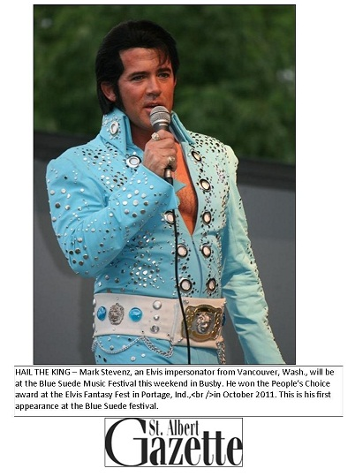
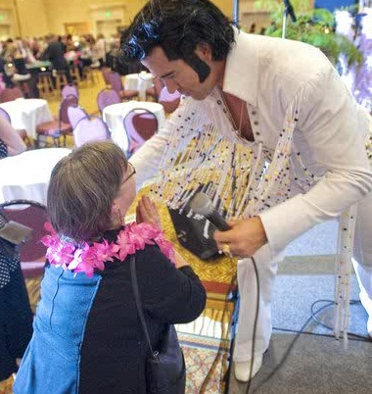
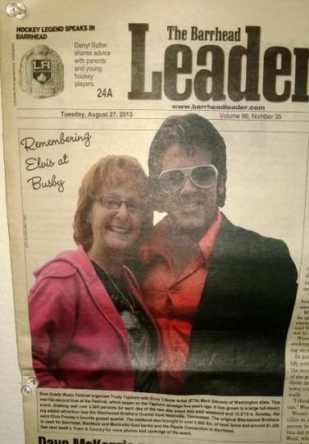
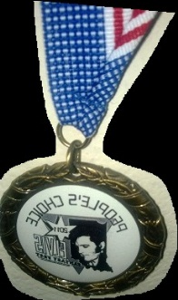
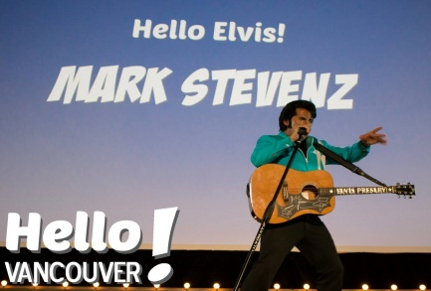
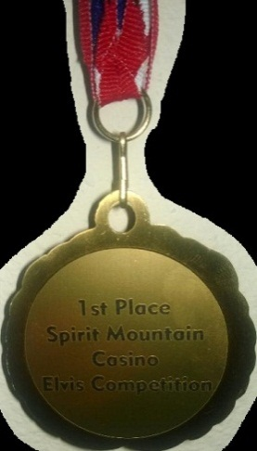
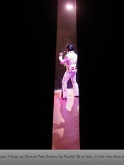
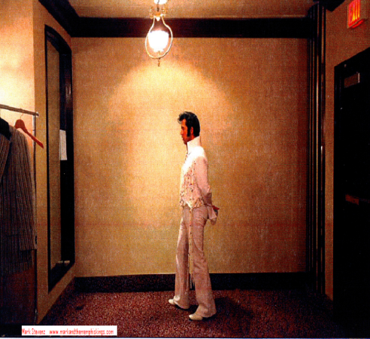
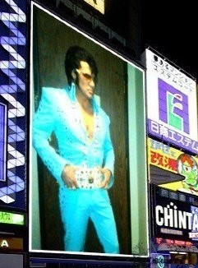
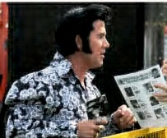
Some Media Highlights
Mesquite Nevada News
Canada
Alberta, Canada
Front page the Columbian, Vancouver, WA
Mark Stevenz performing American Trilogy as Elvis at Pala Casino for Rockin' Elvis fest, in this view from backstage. — John Gastaldo UTSandiego.com
Las Vegas Review Journal
Penticton Western News Front Page
Penticton, BC Canada

Slide 7
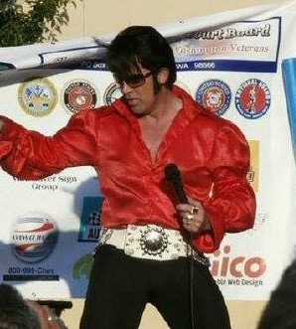
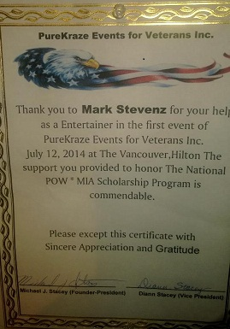
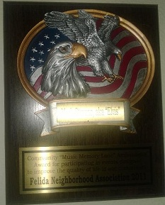
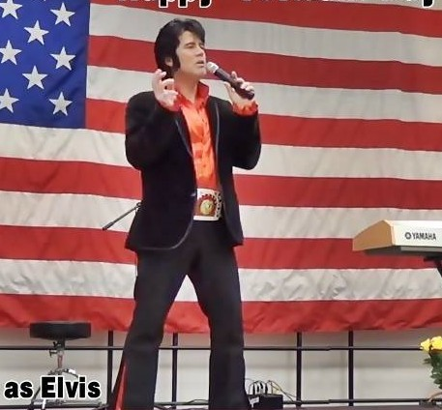
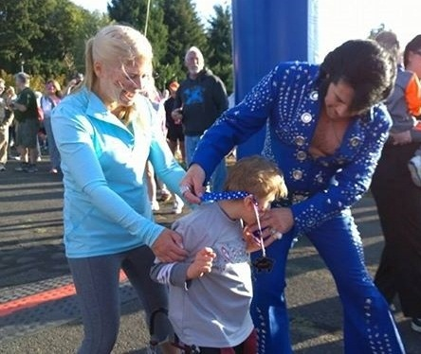
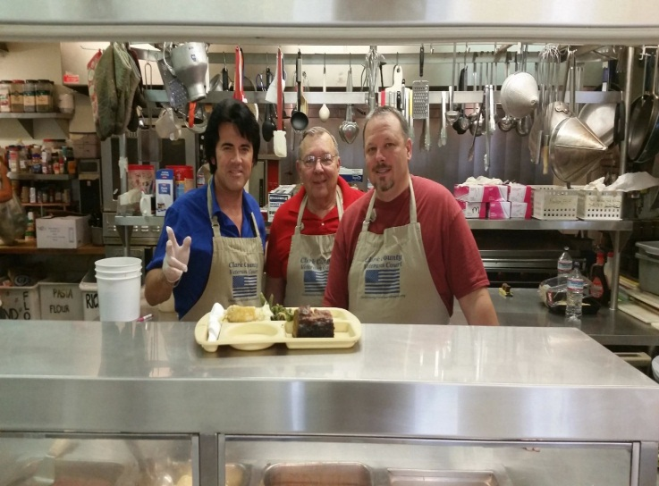
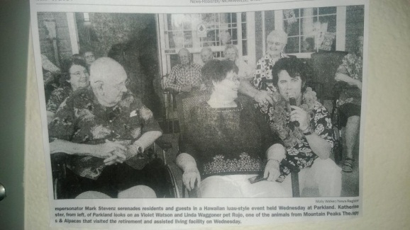
Mark Stevenz is involved with many fantastic charitable organizations a few of which include Share, F.I.D.O, the Salvation Army, the Great Bacon Race, American Cancer Society, the ARC & the Veterans Court Board
PHILANTHROPY

Slide 8
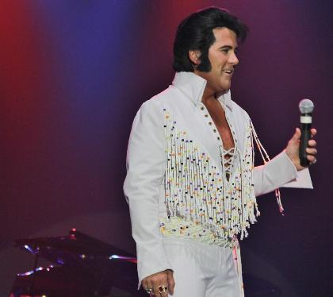
FOR BOOKINGS & INFO:
Management Team:
Nikki Schrade
Judy Davis
MNJS Productions
360.690.6625
MNJSproductions@gmail.com
markmemphiskings@gmail.com
www.markandthememphiskings.com
www.MNJSproductions.wix.com/tributes
Video Link
Social Media Link
Website Link

